Slide 1
Software Engineering Project
Niner Rater
Ian York
Eric Chaves
Ronnie Johnston
Dylan D’Eloia
Gabriel Van Dreel

Slide 2
Product Overview
Students at UNC Charlotte want a better way to rate their professors
Professors play a major role in students’ success in course
Reviewing and rating professors allows students to choose the best fit for them when registering based on feedback from past students
Professors can view their ratings to make changes to their courses
Product being specific to UNC Charlotte allows for an overview of professors in a more catered manner

Slide 3
Product Vision
Mission: To create an interactive database to track Professor Ratings at UNCC. We will use a third party authentication service for user account creation and maintenance.
FOR University of North Carolina at Charlotte students and professors.
Students WHO do not know or can not decide between which UNCC classes to register for.
The “Niner Rater” application is an educational and social networking application.
THAT key benefit/compelling reason to use is gaining depth and detailed advice on UNCC courses and professors. We want students to have the best college experience.
UNLIKE other platforms like Rate My Professor because it is strictly for UNCC Professors. Ratings and Reviews will be much more elaborate and specified within the specific college.
OUR PRODUCT is much closer to home and can be adopted by any University (not just UNCC).

Slide 4
Our Audience
UNC Charlotte students who are trying to plan their upcoming class schedules
UNC Charlotte students who have taken courses and would like to give feedback on their experience with their professors
UNC Charlotte professors looking to make changes to their class format or teaching style based on feedback directly from past students
UNC Charlotte administrators looking for metrics on student’s opinions of certain professors

Slide 5
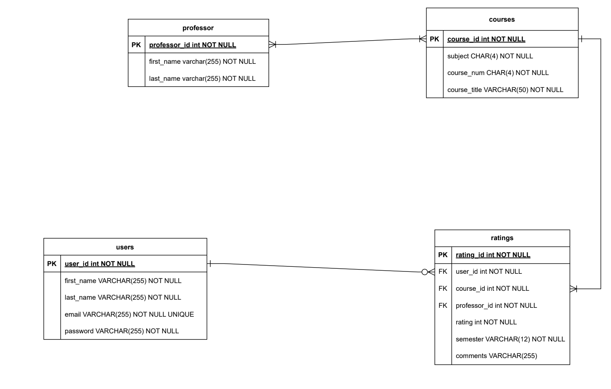
Entity Relationship Diagram

Slide 6
Future Enhancements
Ratings based on different metrics instead of only one overall rating
Ability to submit anonymously
Captcha or other system to prevent false or spam reviews
“Report Rating” feature for users to report abusive or inappropriate ratings

Slide 7
Major Challenges and Lessons Learned
Highly collaborative project environment
Used Trello to manage tasks and user stories
For some, this was their first project done in Python Flask and SQLAlchemy
Delegating work, making sure everyone is working towards the same goal
Lessons
Learning how to work in a collaborative environment using Github
Solving problems collaboratively through branches and merging
Learning to implement databases with a backend
Learning to develop API for CRUD operations on a software entity

Slide 8
Product Demonstration

